Slide 1
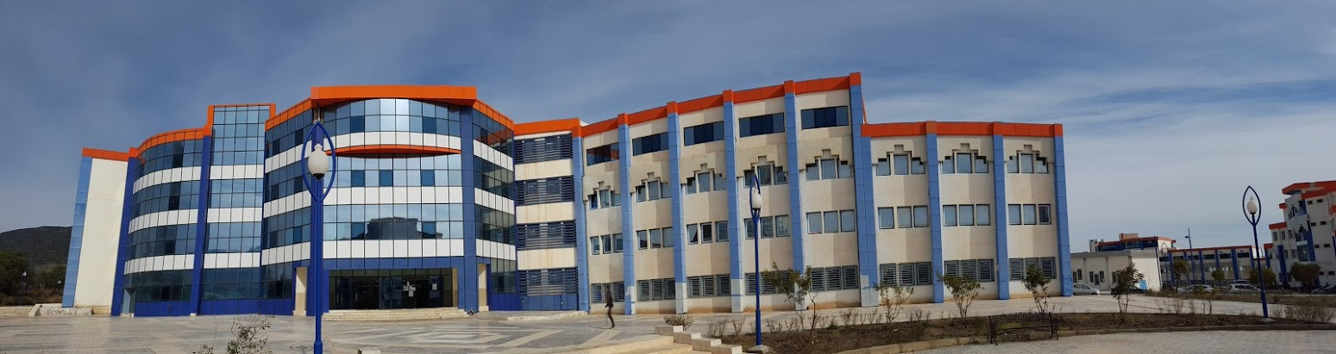


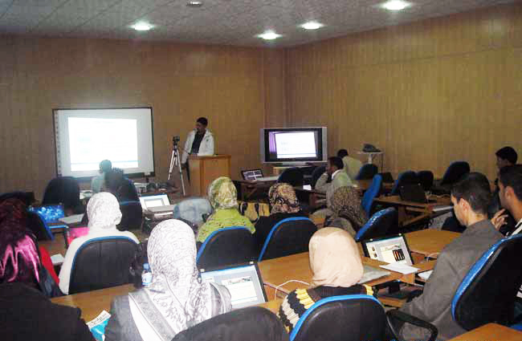
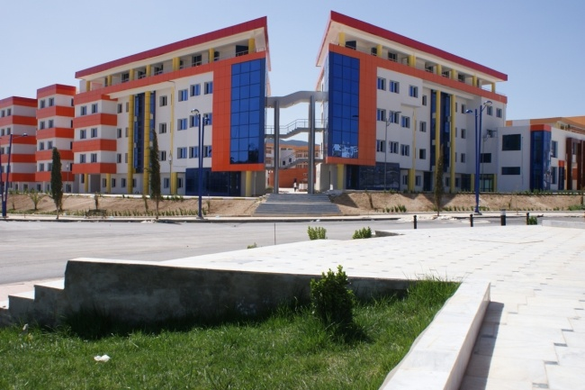
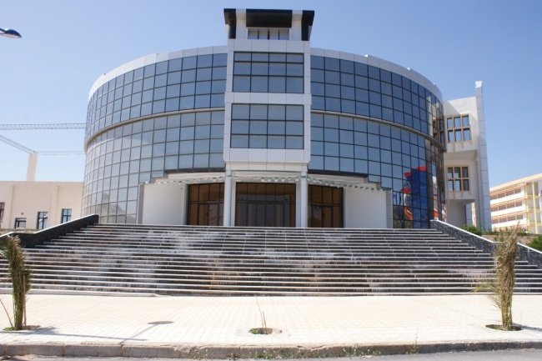
Welcome to
The University of Batna 2

Slide 2
My Country Algeria

Slide 3
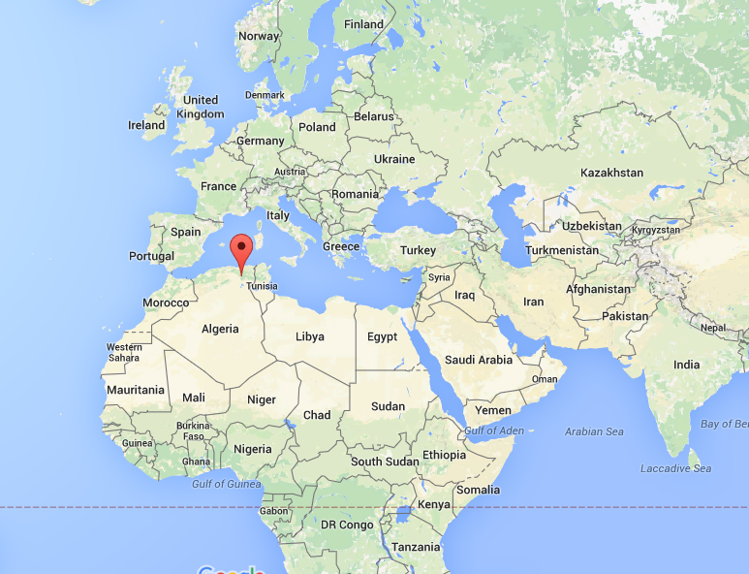
Algeria is the tenth-largest country in the world, and the largest in Africa and the Arab world.
Total area: 919,590 sq mi (2,381,741 sq km)
Population (2014 est.): 38,813,722
Capital and largest city (2011 est.) :
Algiers, 2,916,000
Other large cities: Oran, 783,000; Constantine, 530,100; Batna, 309 142; Annaba, 246,700
Monetary unit: Dinar

Slide 4
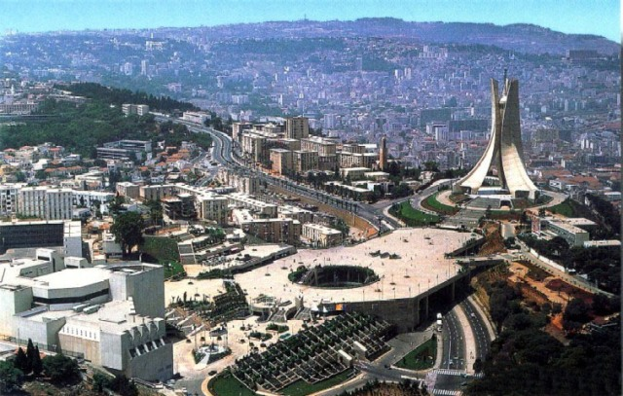
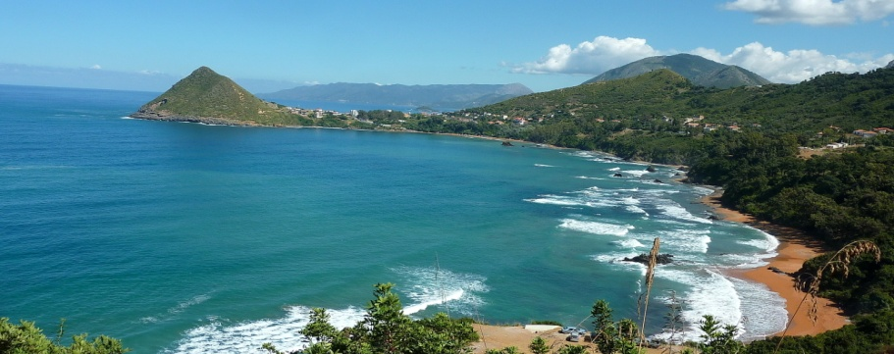
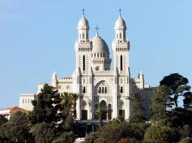
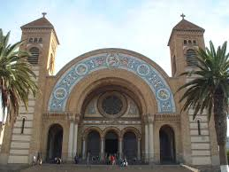
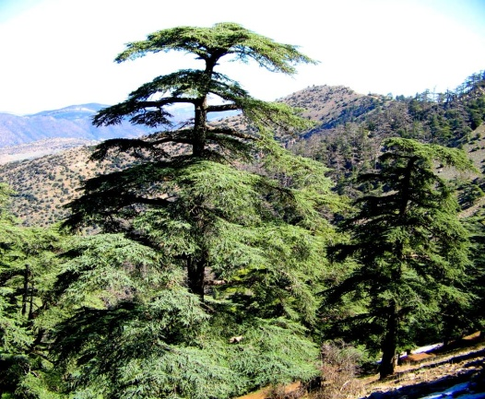
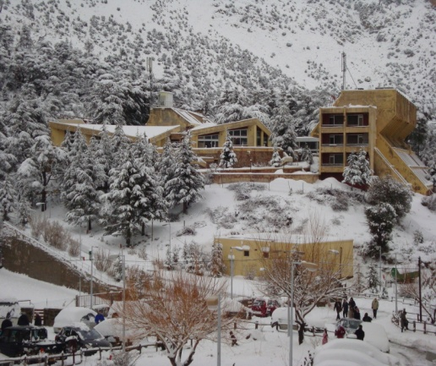
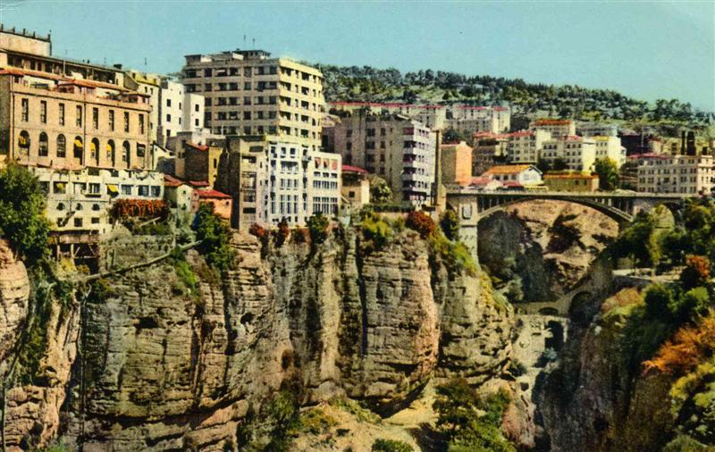
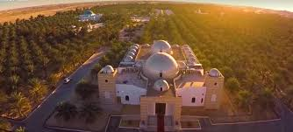
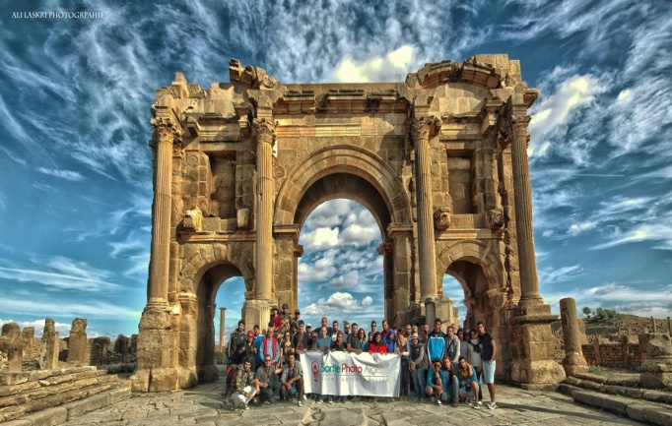
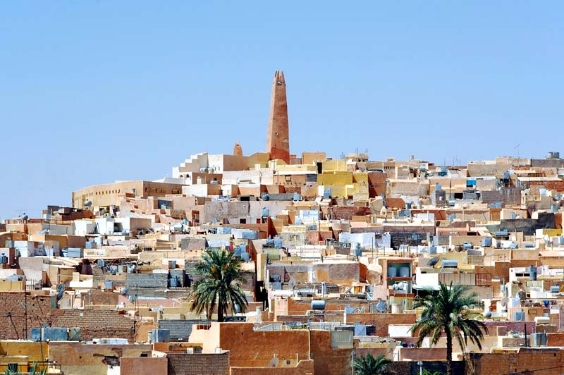
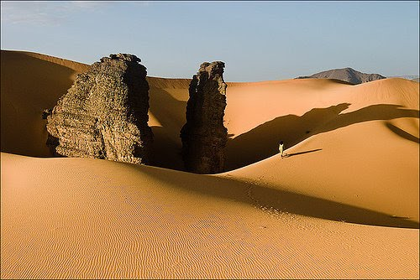
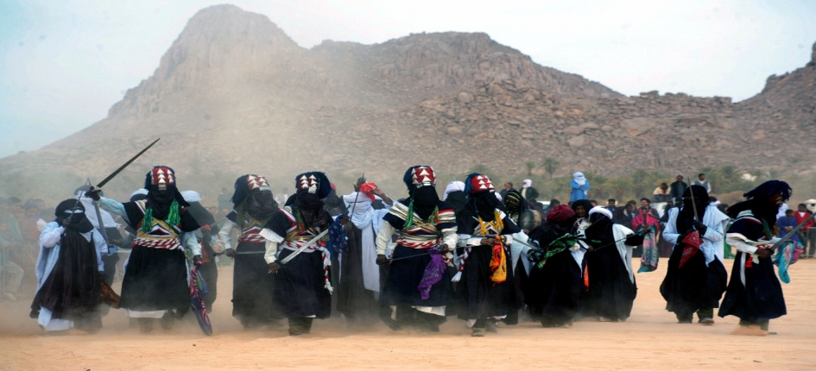
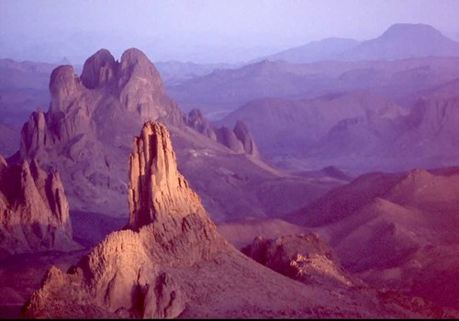

Slide 5
My City Batna

Slide 6
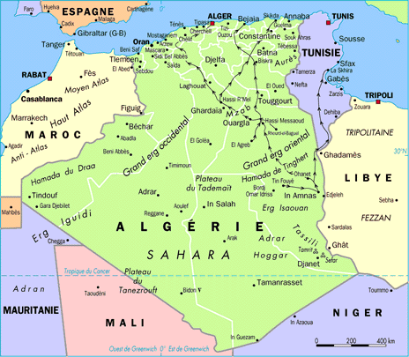
Batna city
Batna with a population of 309 142 is the fifth largest city in Algeria. It is also one of the principal cities of the Chaoui area and is considered the capital of the Aures.
A strategic position in Algeria facilitating national and international trade.
A highly developed infrastructure network: Batna is 120 km from the provinces of
  Constantine
  Sétif
  Biskra
  Oum El Bouaghi
  Khenchela
Batna is the name of both a city and a province in north eastern Algeria. Geographically speaking, Batna is located between the north and south Atlas Mountains and this means that the mountains rise on either side to form a sort of naturally protective passage over the province. The climate tends to vary quite widely - with extreme heat during the summer and snow and cold during the winter.
If you visit Batna, make sure that you visit the nearby ruins of Timgad and Lambaesis. Both were ancient Roman cities and learning their stories will really captivate the imagination.

Slide 7
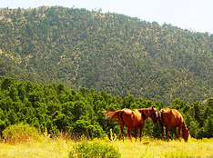
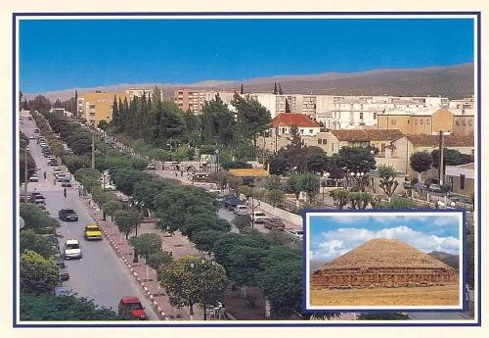
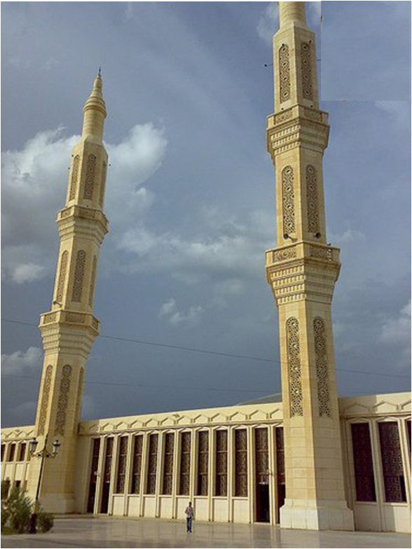
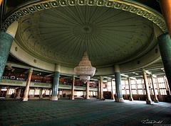
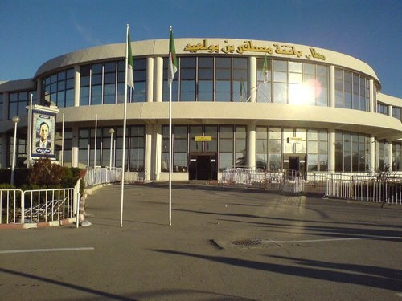
Batna, a dynamic city with a rich historical heritage and tourism

Slide 8
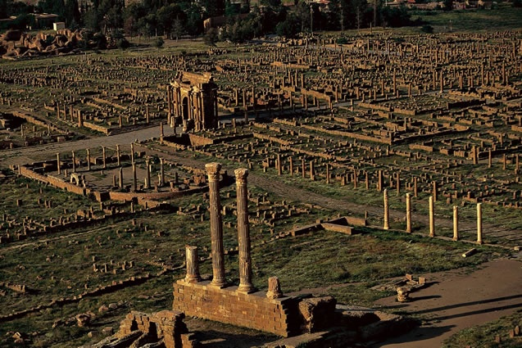
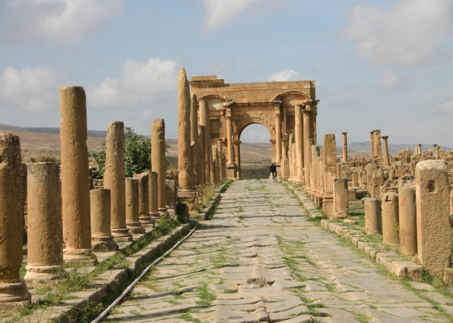
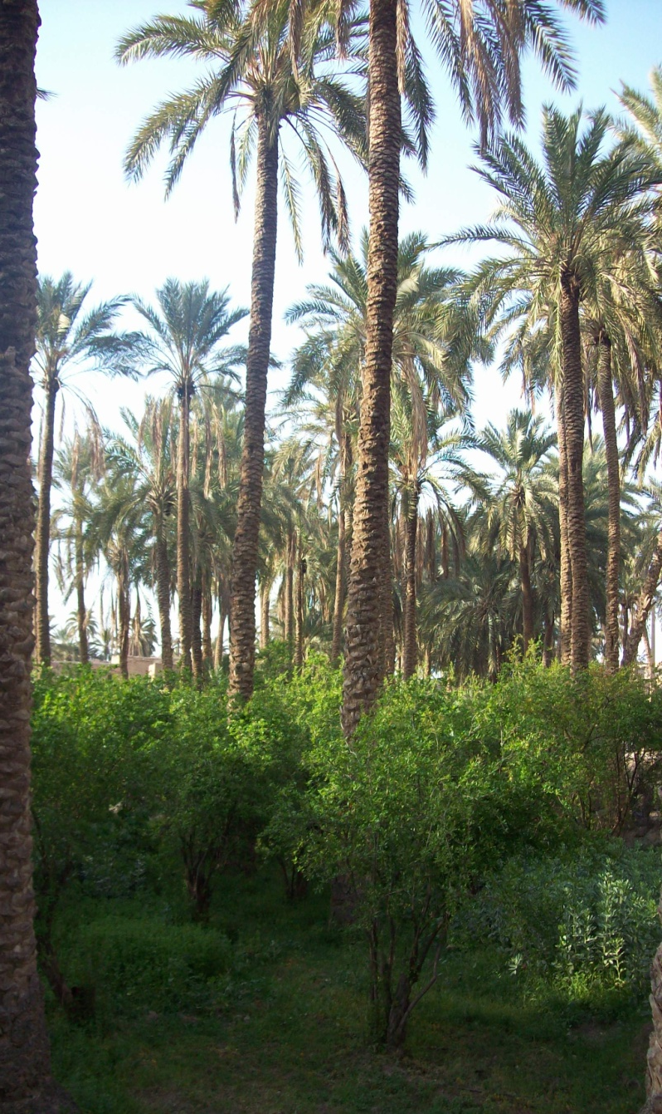
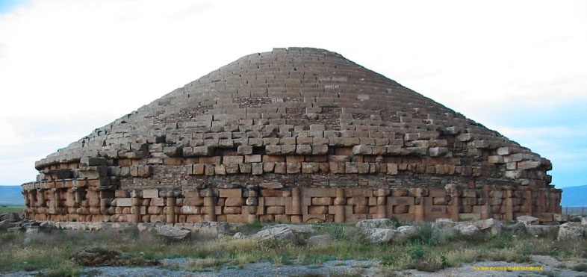
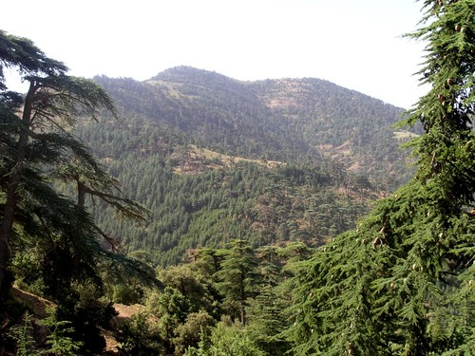
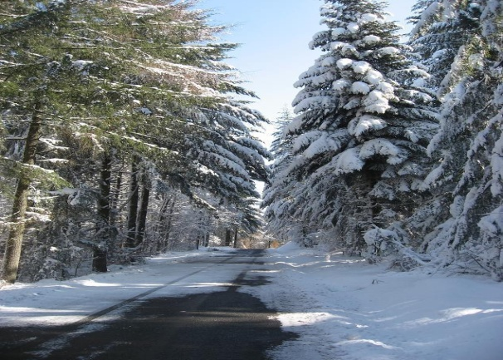

Slide 9
My university Batna 2

Slide 10
The University of Batna 2 today
The old new university
founded in 1977 as University of Batna (also named "Hadj Lakhdar University" )
restructured on July 2015 by presidential decree, which led to a split into two distinct universities, namely University of Batna 1 and University of Batna 2.
Now UB2 University is one of the largest Universities in Algeria and Africa with its (29,671) enrolled students and (1,833) staff members.
Under the authority of the chancellor Dr. Tayeb BOUZID the University comprises a general management office,
(04) vice-rectorates,
(05) Faculties,
(03) Institutes,
and a Central Library.

Slide 11
The University of Batna 2 today
Currently the University of Batna 2 Includes:
32163 Students
1562 Students in Postgraduate study
1086 Teachers
26 research laboratories
02 Technology Halls
01 research unit on solar energy
01 Cleanroom

Slide 12
In July 2015 avril 2010, the University of Batna 2 is organized into 05 faculties and 03 Institutes :
Faculties
Faculty of Life and Natural Sciences
Faculty of Technology
Faculty de Medicine
Faculty of Mathematics and Computer Science
Faculty of Foreign Languages and Literatures
Institutes
Institute of Hygiene and Industrial Safety
Institute of Earth Science and Universe .
Institute of Sciences and Techniques of Physical and Sports Activities

Slide 13
Departments in Faculties and Institutes
Faculty de Medicine | Faculty of Life and Natural Sciences | Institute of Sciences and Techniques of Physical and Sports Activities
Medicine | Organisms Biology | Adaptive sports activities
pharmacy | Microbiology and Biochemistry | Sports training
Technology | Ecology & Environmen | Eduaction and motor skills
Industrial Engineering | Mathematics and Computer Science | Hygiene and Industrial Safety
hydraulic | Mathematics | Working conditions
Civil Engineering | Computer Science | Environmental Science
Electronics | Foreign Languages and Literatures | Industrial Safety
Electrical Engineering | French | Earth Science and Universe
Mechanical Engineering | English | Geology
 |  | Geography and Regional Planning

Slide 14
Faculty of Technology
Teachers | Bachelor’s level | Master’s level | Total
343 | 4142 | 1642 | 5784
07 Departments | students | Teachers
hydraulic | 201 | 25
Civil Engineering | 540 | 36
Electronics | 700 | 56
Electrical Engineering | 726 | 70
Industrial Engineering | 230 | 25
Mechanical Engineering | 607 | 60
common core department | 2780 | 71
26 research laboratories

Slide 15
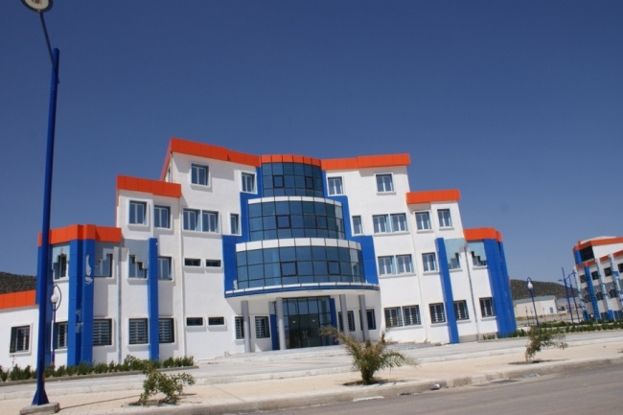

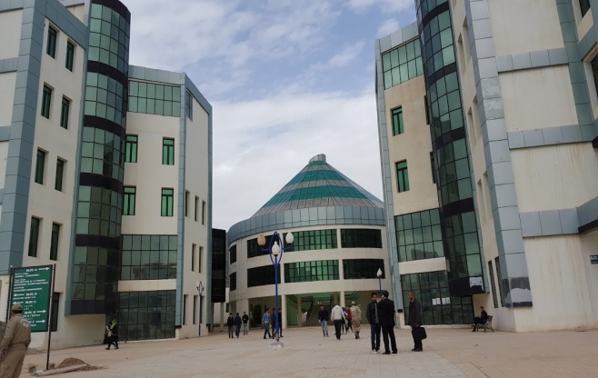
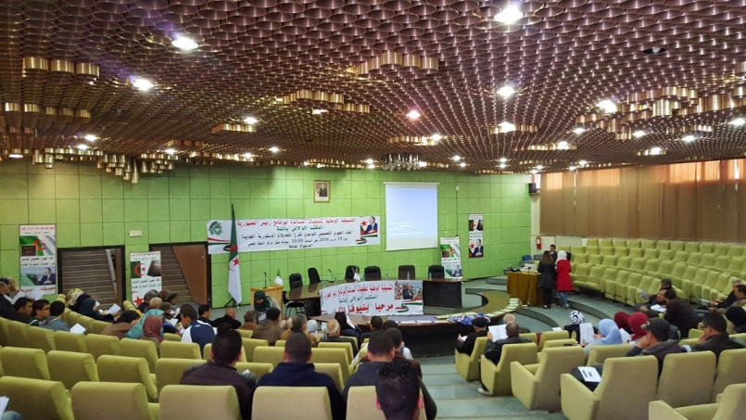
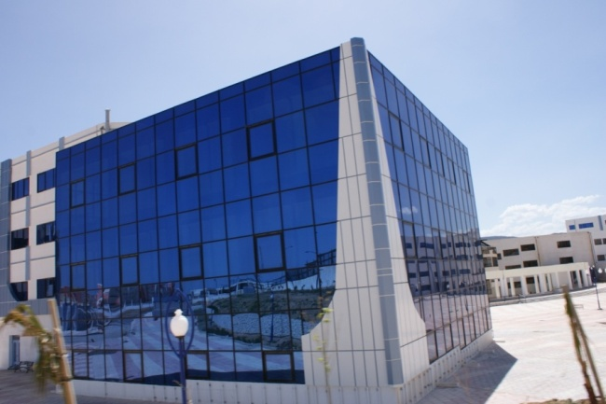
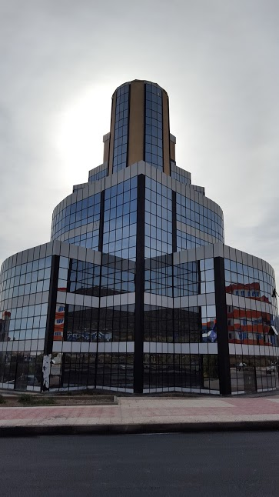
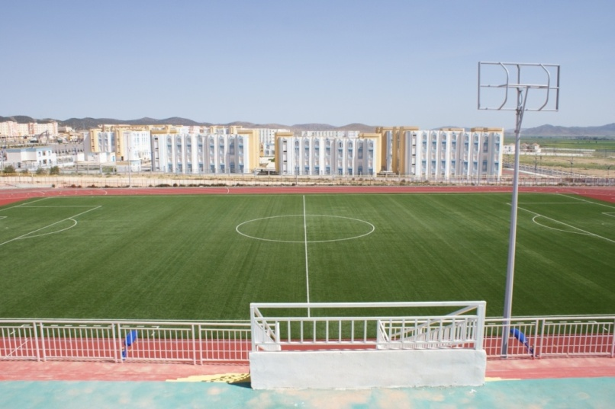


Slide 16




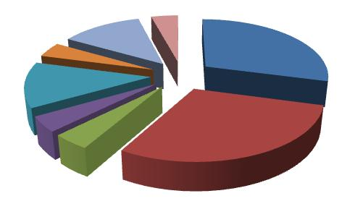
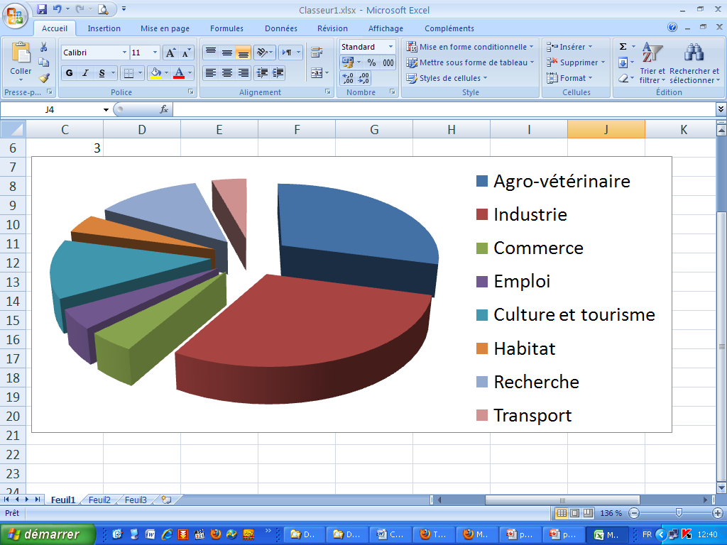











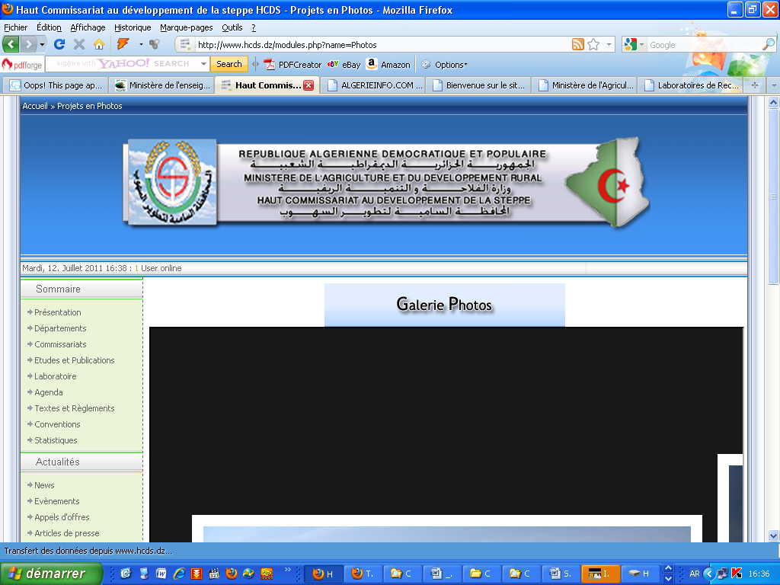
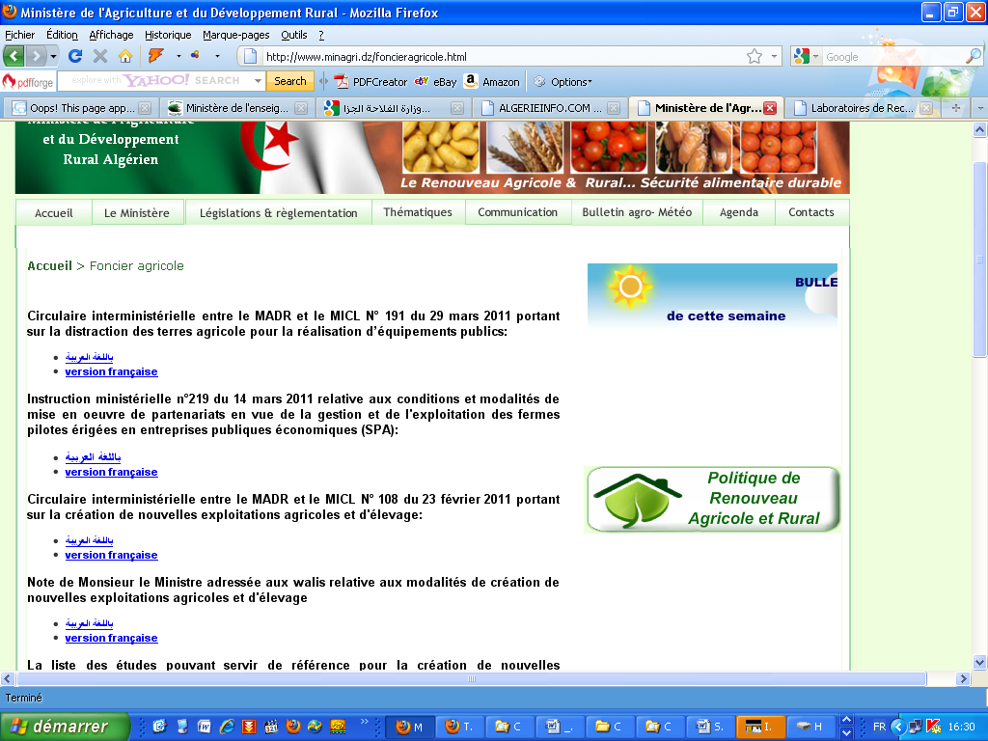



NATIONAL COOPERATION AGREEMENT
24 COOPERATION AGREEMENTS
 | Ministère de l’Industrie et de la Promotion des Investissements | Direction des Moudjahidines de la Wilaya de Batna | Directoire du Groupe Avicole de l’Est | Conservation des forêts de la wilaya de Batna | Laiterie Aurès -Batna- | Groupe SAIDAL
Direction du Tourisme et de l'Artisanat Traditionnel |  |  |  |  |  | Office national de la météorologie -O.N.M-
Chambre de commerce et d’industrie des Aures –CCIA |  |  |  |  |  | Laboratoire de l’habitat et de la construction-Sud
Ecole Nationale d’Application des Techniques des Transports Terrestres | Société de Maintenance des Equipements Industriels (MEI-M’Sila) | Unité de Recherche Appliquée en Energies Renouvelables | Centre de Recherche Scientifique en Soudage et Contrôle | Centre de Recherche Scientifique et Technique sur les Régions Arides | Société des Ciments de Ain-Touta - SCIMAT- | Direction des pèches et des ressources Halieutiques de wilaya Setif
Société de fabrication de semi-remorques SARL TIRSAM | Agence Nationale de Soutien à l’Emploi des Jeunes -ANSEJ | Haut Commissariat au Développement de la Steppe | Direction des services Agricoles de la wilaya de Batna | Société d'études et d'agencement de laboratoires - TRIPODE - | Société de fabrication d'emballage métallique SARL BENPACK | Direction de la radio -Batna-
MIPI
DGAE

Slide 17

INTERNATIONAL COOPERATION
22 COOPERATION AGREEMENTS

Slide 18
TEMPUS Project
EOLES : Electronic and Optic e-Learning for Embedded Systems
Creation of 3rd year Bachelor degree
2012
ISTEMAG : Optimized Access to Scientific and Technical Information in the maghreb countries
2010

Slide 19
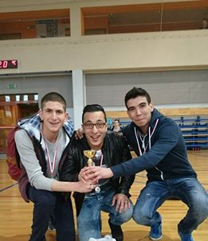
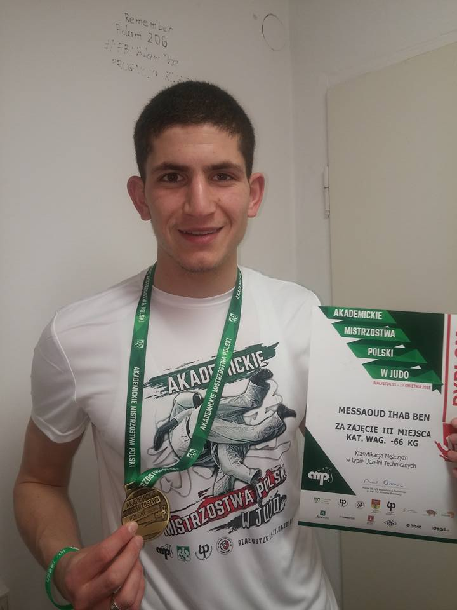
Erasmus +
Bialystok University of Technology –Poland
Riga Technical University -Riga –Latvia
University of Trento –Trento-Italy
Piraeus University –Piraeus – Greece
Nis University -Belgrade-Serbia
Instituto Politécnico de Castelo Branco-Portugal

Slide 20

For more informations: http://www.univ-batna2.dz
Thanks….

Slide 21


